Slide 1
CHAPTER 17
Model Building
to accompany
Introduction to Business Statistics
seventh edition, by Ronald M. Weiers
Presentation by Priscilla Chaffe-Stengel
Donald N. Stengel
© 2011 Cengage Learning.
All Rights Reserved. May not be scanned, copied, or duplicated, or posted to a publicly accessible website, in whole or in part.

Slide 2
Chapter 17 - Learning Objectives
Build polynomial regression models to describe curvilinear relationships.
Apply qualitative variables representing two or three categories.
Use logarithmic transforms in constructing exponential and multiplicative models.
Identify and compensate for multicollinearity.
Apply stepwise regression.
Select the most suitable among competing models.
© 2011 Cengage Learning.
All Rights Reserved. May not be scanned, copied, or duplicated, or posted to a publicly accessible website, in whole or in part.

Slide 3
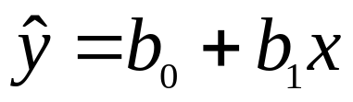
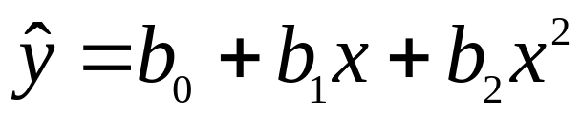
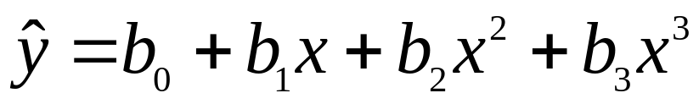
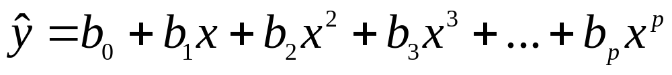
Polynomial Models with One Quantitative Predictor Variable
Simple linear regression equation:
Equation for second-order polynomial model:
Equation for third-order polynomial model:
Equation for general polynomial model:
© 2011 Cengage Learning.
All Rights Reserved. May not be scanned, copied, or duplicated, or posted to a publicly accessible website, in whole or in part.

Slide 4
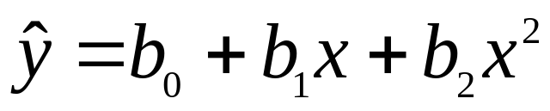
Example with One Quantitative Predictor Variable, Problem 17.8
Problem 17.8: During the years 2005 – 2009, the world record for the 100-meter dash was repeatedly broken as never before. Using x = 1 through 5 to represent 2005 – 2009, fit a second-order polynomial model to the data and estimate the world record time for the 100-meter dash in 2014.
The regression equation
will have the form:
Year | x = Yr | y = time
2005 | 1 | 9.77
2006 | 2 | 9.77
2007 | 3 | 9.74
2008 | 4 | 9.69
2009 | 5 | 9.58
© 2011 Cengage Learning.
All Rights Reserved. May not be scanned, copied, or duplicated, or posted to a publicly accessible website, in whole or in part.

Slide 5
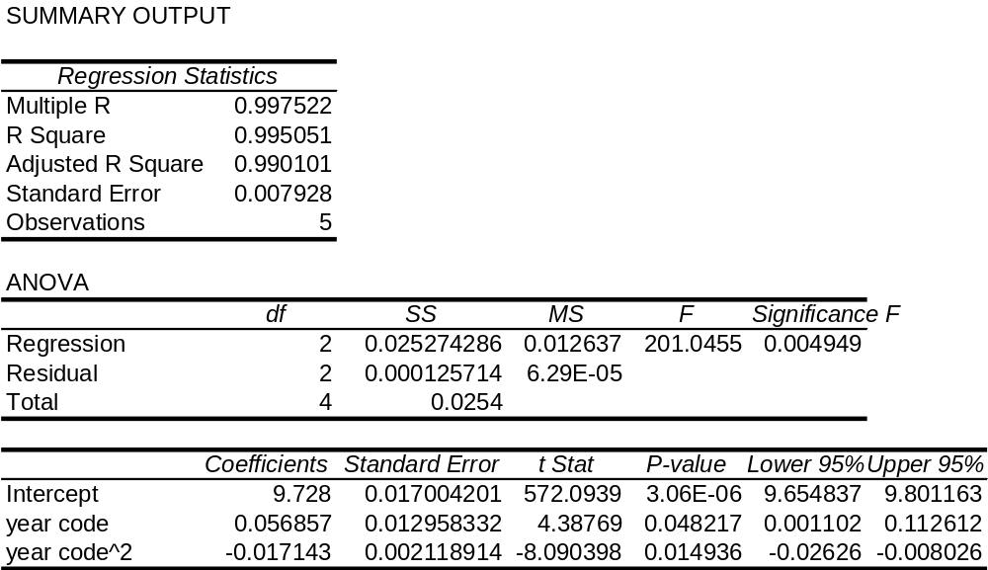

Example, Problem 17.8, cont.
Using Excel Output
The regression equation is:
© 2011 Cengage Learning.
All Rights Reserved. May not be scanned, copied, or duplicated, or posted to a publicly accessible website, in whole or in part.

Slide 6

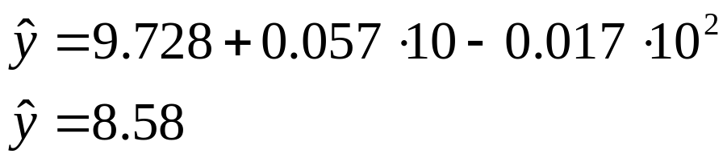
Example, Problem 17.8, cont.
To estimate the world record time for the 100-meter dash in 2014, evaluate when x = 10.
So the world record time is predicted to be 8.58 seconds in 2014.
Does this make sense? Of course not.
Explanation: Although the polynomial equation provides a good fit for the data during the period 2005-2009, this form is not appropriate to extrapolate the data out to 2014, which is well beyond the extent of the original data.
© 2011 Cengage Learning.
All Rights Reserved. May not be scanned, copied, or duplicated, or posted to a publicly accessible website, in whole or in part.

Slide 7
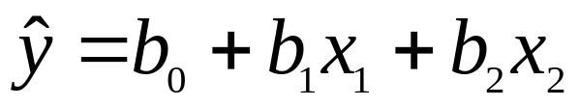
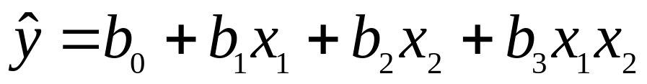
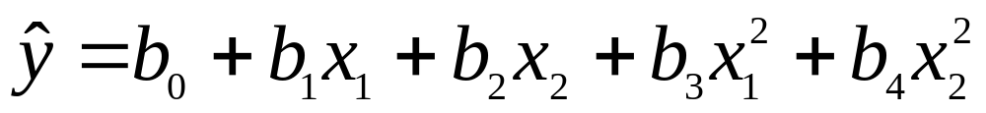
Polynomial Models with Two Quantitative Predictor Variables
First-order model with no interaction:
First-order model with interaction:
Second-order model with no interaction:
Second-order model with interaction:
© 2011 Cengage Learning.
All Rights Reserved. May not be scanned, copied, or duplicated, or posted to a publicly accessible website, in whole or in part.

Slide 8
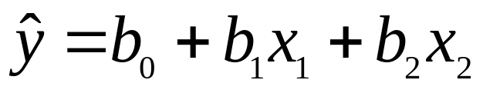
Models with Qualitative Variables
Equation for a model with a categorical independent variable with two possible states:
  where state 1 is shown x = 1
  where state 2 is shown x = 0
Equation for a model with a categorical independent variable with three possible states:
  where state 1 is shown x₁ = 1, x₂ = 0
  where state 2 is shown x₁ = 0, x₂ = 1
  Where state 3 is shown x₁ = 0, x₂ = 0
© 2011 Cengage Learning.
All Rights Reserved. May not be scanned, copied, or duplicated, or posted to a publicly accessible website, in whole or in part.

Slide 9
Example, Problem 17.29
An efficiency expert has studied 12 employees who perform similar assembly tasks, recording productivity (units per hour), number of years of experience, and which one of three popular assembly methods the individual has chosen to use in performing the task. Given the data, shown on the next slide, determine the linear regression equation for estimating productivity based on the other variables. For any qualitative variables that are used, be sure to specify the coding strategy each will employ.
© 2011 Cengage Learning.
All Rights Reserved. May not be scanned, copied, or duplicated, or posted to a publicly accessible website, in whole or in part.

Slide 10
Example, Problem 17.29, cont.
Worker | Prod. | Yrs.Exp | Method | Worker | Prod. | Yrs.Exp | Method
1 | 75 | 7 | A | 7 | 97 | 12 | B
2 | 88 | 10 | C | 8 | 85 | 10 | C
3 | 91 | 4 | B | 9 | 102 | 12 | C
4 | 93 | 5 | B | 10 | 93 | 13 | A
5 | 95 | 11 | C | 11 | 112 | 12 | B
6 | 77 | 3 | A | 12 | 86 | 14 | A
© 2011 Cengage Learning.
All Rights Reserved. May not be scanned, copied, or duplicated, or posted to a publicly accessible website, in whole or in part.

Slide 11
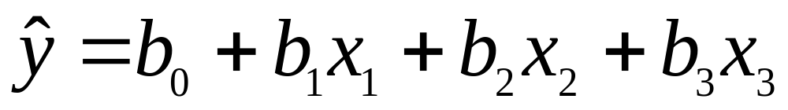
Example, Problem 17.29, cont.
The equation for a model with one quantitative variable and a categorical independent variable with three possible states is:
  where x₁ represents the years of experience
  where state 1 is shown x₂ = 1 if method A is used,
  0 if otherwise
  where state 2 is shown x₃ = 1 if method B is used,
  0 if otherwise
  where state 3 is shown x₂ = 0 and x₃ = 0 if method C is used.
© 2011 Cengage Learning.
All Rights Reserved. May not be scanned, copied, or duplicated, or posted to a publicly accessible website, in whole or in part.

Slide 12
Example, Problem 17.29, cont.
So the data to be analyzed are:
Worker | y | x₁ | x₂ | x₃
1 | 75 | 7 | 1 | 0
2 | 88 | 10 | 0 | 0
3 | 91 | 4 | 0 | 1
4 | 93 | 5 | 0 | 1
5 | 95 | 11 | 0 | 0
6 | 77 | 3 | 1 | 0
© 2011 Cengage Learning.
All Rights Reserved. May not be scanned, copied, or duplicated, or posted to a publicly accessible website, in whole or in part.

Slide 13
Example, Problem 17.29, cont.
Worker | y | x₁ | x₂ | x₃
7 | 97 | 12 | 0 | 1
8 | 85 | 10 | 0 | 0
9 | 102 | 12 | 0 | 0
10 | 93 | 13 | 1 | 0
11 | 112 | 12 | 0 | 1
12 | 86 | 14 | 1 | 0
© 2011 Cengage Learning.
All Rights Reserved. May not be scanned, copied, or duplicated, or posted to a publicly accessible website, in whole or in part.

Slide 14
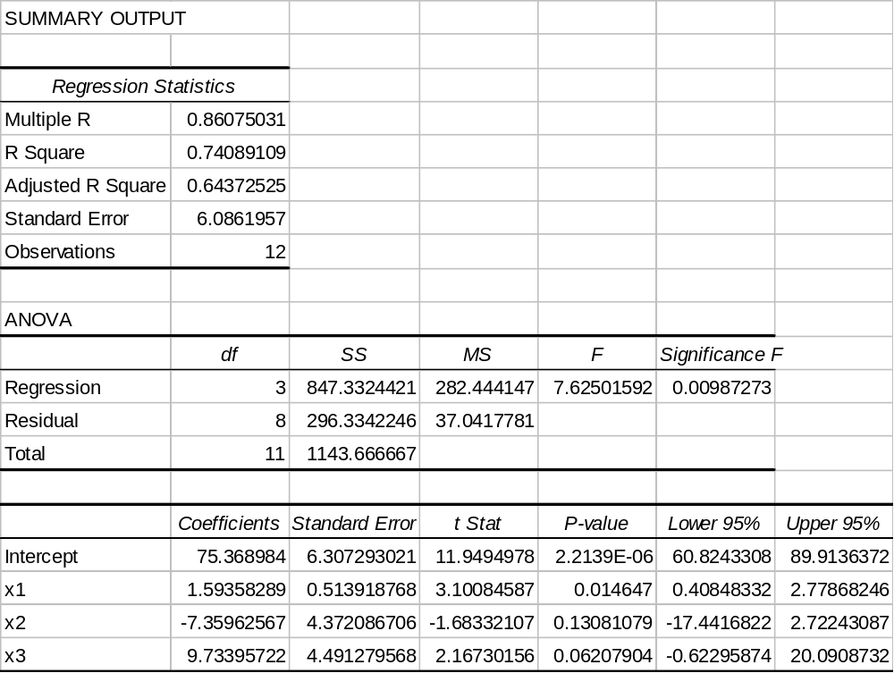
Example, Problem 17.29, cont.
Using Excel output:
The regression equation is:
© 2011 Cengage Learning.
All Rights Reserved. May not be scanned, copied, or duplicated, or posted to a publicly accessible website, in whole or in part.

Slide 15
Example, Problem 17.29, cont.
The regression equation has an adjusted R-square of 0.644. This indicates that the regression model provides a reasonable explanation for the variation in the data set.
Only the coefficient for x₁ is significant at the 0.05 level. One might consider removing the assembly method from the model.
© 2011 Cengage Learning.
All Rights Reserved. May not be scanned, copied, or duplicated, or posted to a publicly accessible website, in whole or in part.

Slide 16
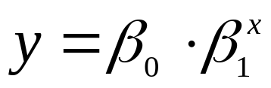
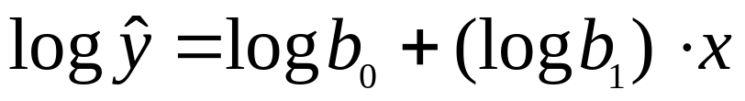
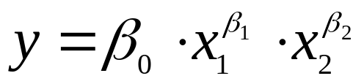
Models with Data Transformations
Exponential Model:
General equation for an exponential model:
Corresponding linear regression equation for an exponential model:
Multiplicative Model:
General equation for a multiplicative model:
Corresponding linear regression equation for a multiplicative model:
© 2011 Cengage Learning.
All Rights Reserved. May not be scanned, copied, or duplicated, or posted to a publicly accessible website, in whole or in part.

Slide 17
Exponential Model:
Example, Problem 17.32
An exponential model will probably be more appropriate to the data used in Problem 17.8.
y | Log y | x
9.77 | 0.989895 | 1
9.77 | 0.989895 | 2
9.74 | 0.988559 | 3
9.69 | 0.986324 | 4
9.58 | 0.981336 | 5
© 2011 Cengage Learning.
All Rights Reserved. May not be scanned, copied, or duplicated, or posted to a publicly accessible website, in whole or in part.

Slide 18
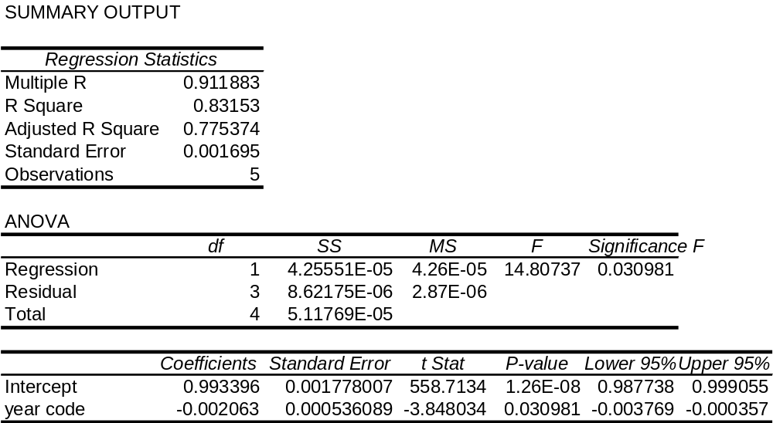

Example, Problem 17.32, cont.
Using Excel output:
The regression equation is:
© 2011 Cengage Learning.
All Rights Reserved. May not be scanned, copied, or duplicated, or posted to a publicly accessible website, in whole or in part.

Slide 19
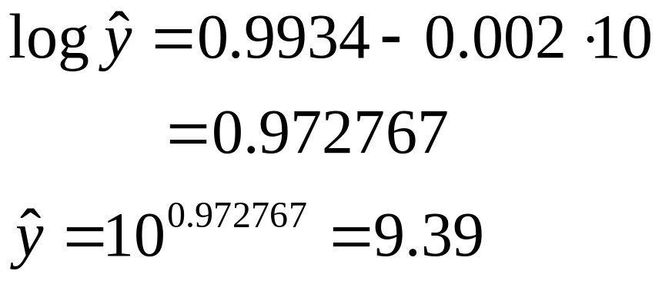
Example, Problem 17.32, cont.
For x = 10,
Based on the exponential model, the world record time for the 100-meter dash will be 9.39 seconds in 2014.
© 2011 Cengage Learning.
All Rights Reserved. May not be scanned, copied, or duplicated, or posted to a publicly accessible website, in whole or in part.

Slide 20
Multicollinearity
Multicollinearity occurs
  When two or more of the x-variables are highly correlated.
  When “independent” variables are not independent, but in fact are highly inter-dependent on each other.
Multicollinearity is not a problem if one’s goal is solely to predict the value of y.
Multicollinearity is a problem when trying to interpret partial regression coefficients:
  Because the value of one variable cannot be held constant while another is altered.
  Because changing the value of one variable influences the value of another variable.
© 2011 Cengage Learning.
All Rights Reserved. May not be scanned, copied, or duplicated, or posted to a publicly accessible website, in whole or in part.

Slide 21
Stepwise-In Regression
Enter into the regression model first the x-variable that explains the greatest variation in y.
  How: Run each variable on y separately as a simple linear regression. Select the variable that has the largest R-square and whose p-value is also less than alpha.
Enter into the regression model next the x-variable that explains the next greatest variation in y.
  How: Pair the variable selected in Step 1 with each of the remaining x-variables and run separate regression analyses. Select a second x-variable whose analysis has the largest R-square and whose p-values are also less than alpha.
Repeat Step 2 until additional x-variables fail to significantly increase R-square and do not have significant p-values.
© 2011 Cengage Learning.
All Rights Reserved. May not be scanned, copied, or duplicated, or posted to a publicly accessible website, in whole or in part.

